Slide 1
Welcome Lane Tech Key Club!
No, we don’t make keys…Sorry to disappoint you!

Slide 2
Let’s Introduce Our Officers
Pay attention, because at the end of the meeting we will give away lollipops to members who will remember names! ☺

Slide 3
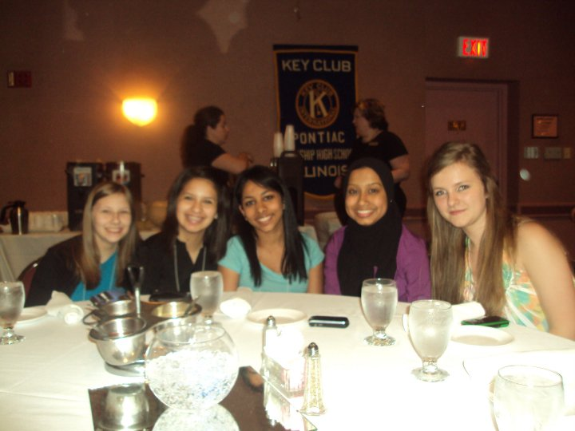
What is Key Club?

Slide 4
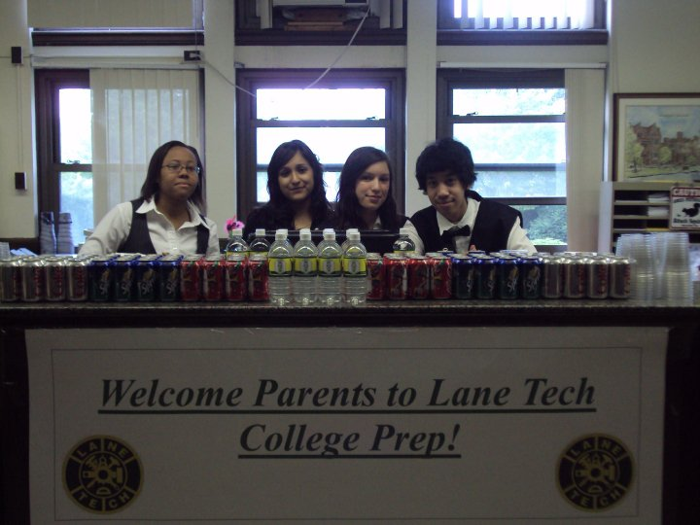
We’re actually pretty important.
Key Club International is an organization of high school students who work together to help children around the world. That’s a pretty big impact. Key Club serves the community, and fundraises for such organizations as: March of Dimes, The Children’s Miracle Network, and UNICEF.
Think about it…
You can be changing the world by being an active member of Key Club!

Slide 5
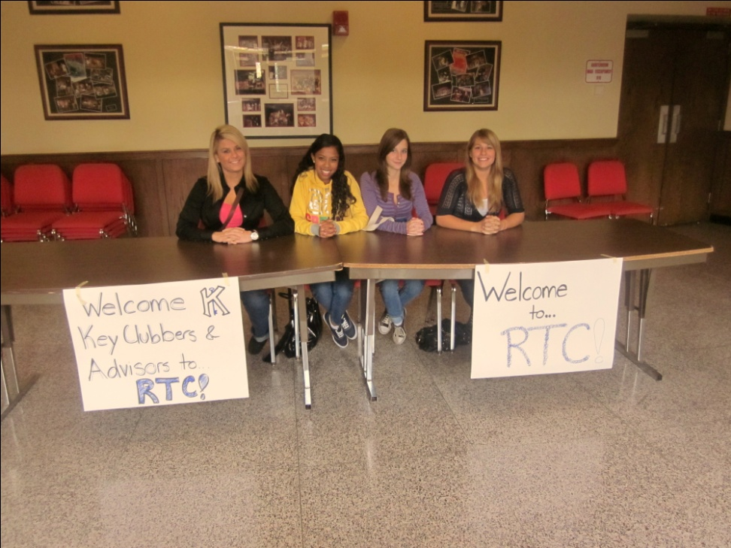
What Do We Do Here at LT?
LT Key Club provides its members with service learning opportunities. We help you get your service hours, but we can help you develop your leadership & communication skills as well.

Slide 6
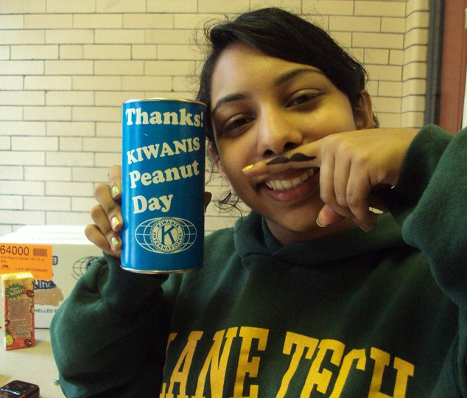
How do we do it?
During each meeting, we give you an agenda with a list of possible service learning projects you could attend to get service hours. You can sign up for them at the meeting or online via e-mail or Facebook!

Slide 7
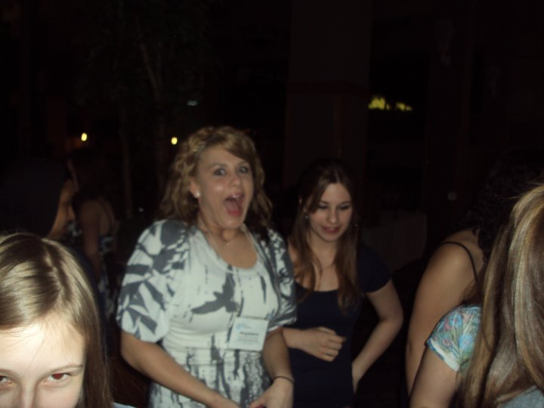
Key Club looks great on college applications too!

Slide 8
District Convention (D-Con)
What the heck is that?

Slide 9
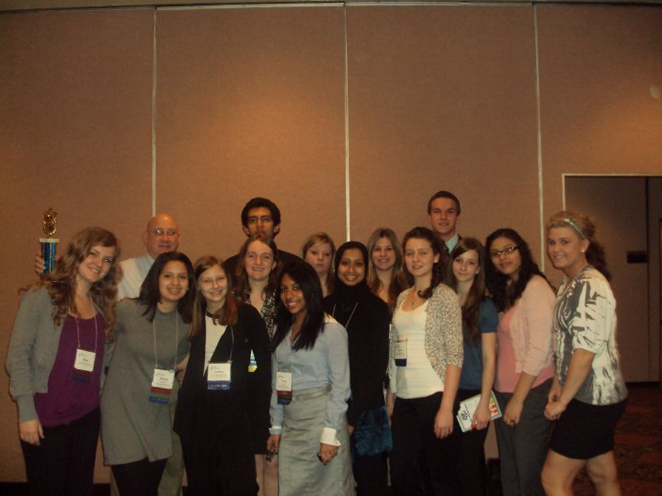
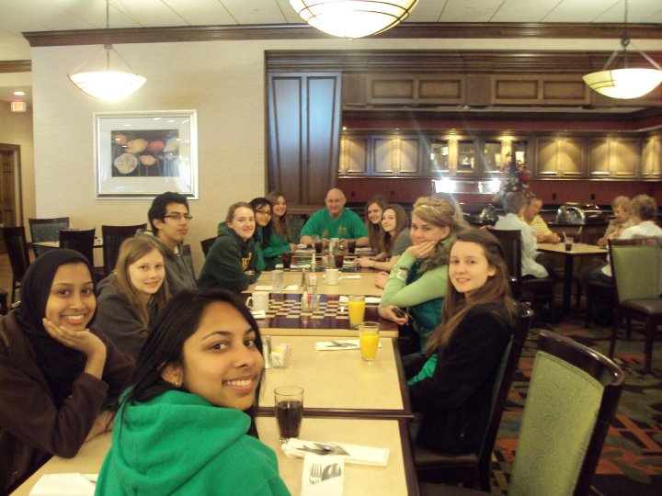
During Convention, you learn more about Key Club…so GO!
We earn our awards at Convention.
We meet people from other Key Clubs in our Illinois-Iowa District

Slide 10
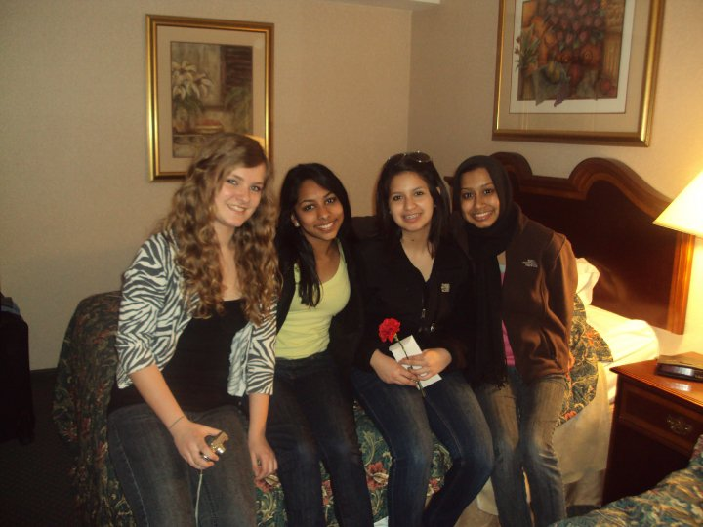
April 8th-10th, 2011
Start saving up for convention! It’s actually really fun and inspiring. This year it will be held in Bloomingdale, Illinois at the Indian Lakes Resort…REALLY LUXURIOUS! ☺

Slide 11
Types of Service Learning Projects
What YOU can do to get service hours through Key Club

Slide 12
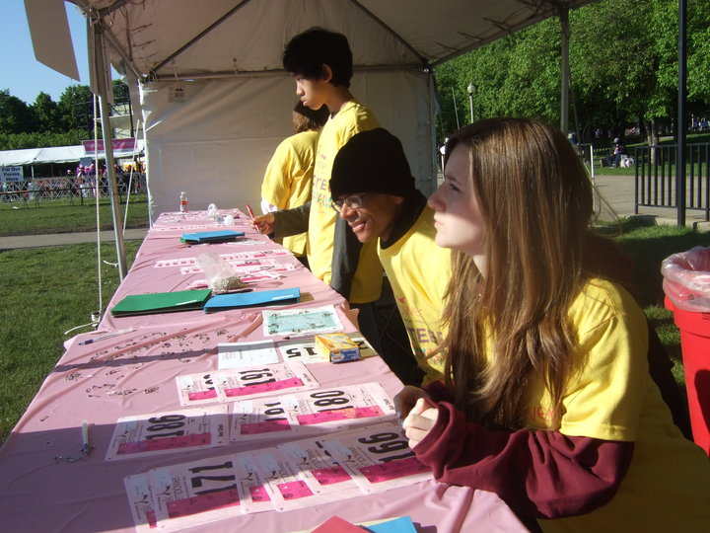
Races/Marathons
Chicago holds a lot of races and marathons. We volunteer at these by setting up for the races, passing out water and bananas to runners, and cheering them on as well. We usually get a lot of t-shirts because of the races we volunteer at!

Slide 13
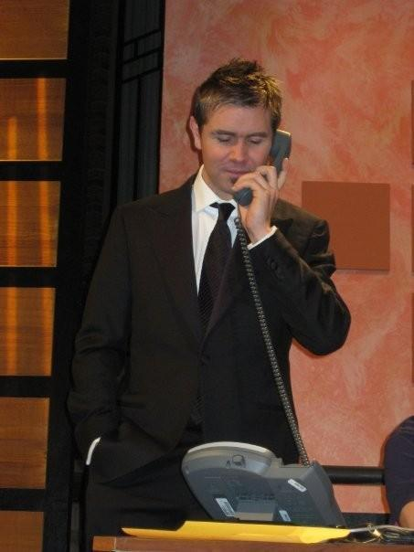
WTTW
Do you know those people who sell stuff after shows on Chanel 11? Well, you could be on TV and earn service hours. You can pick up phone calls and take pledges from people. Be on the look out for this project!

Slide 14
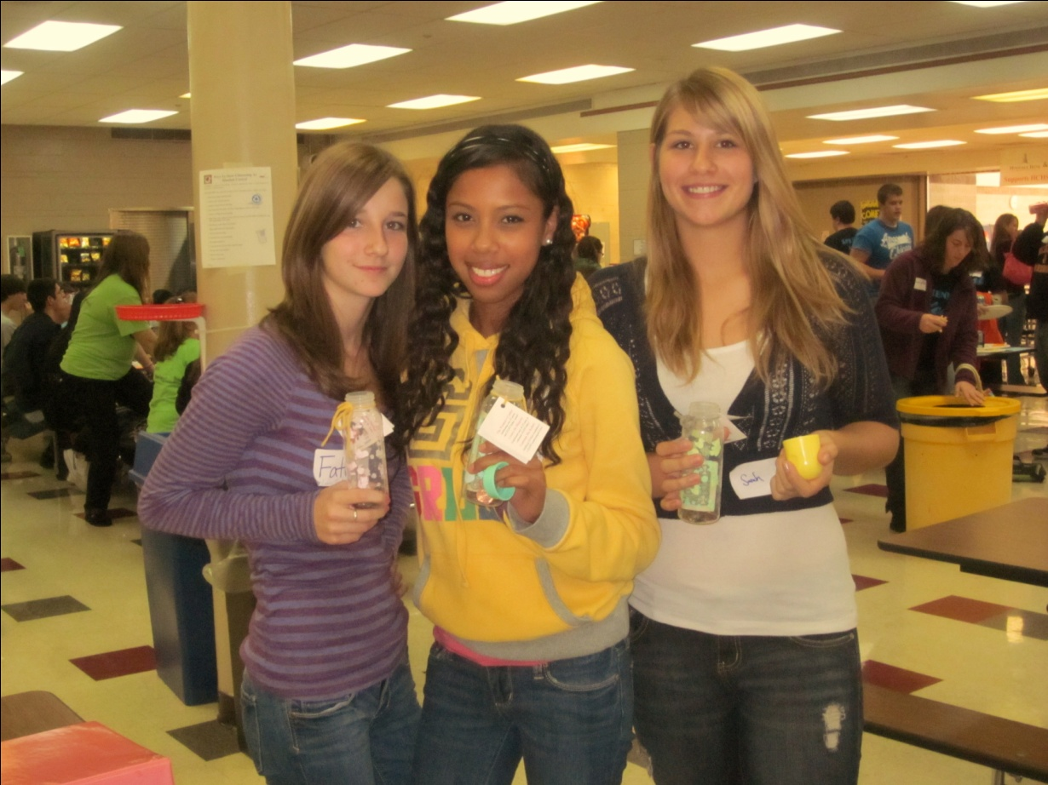
Fundraisers
We fundraise for UNICEF with boxes in which people can make donations. We fundraise for March of Dimes with ribbons, sold and this year, baby bottles filled with people’s donations! Your officers are currently brainstorming ideas for Key Club to fundraise for spastics.

Slide 15
Contact Information
Please take advantage of your resources!
We work hard to make it easy for you & we don’t bite!
If you have any questions, pay attention now! ☺

Slide 16
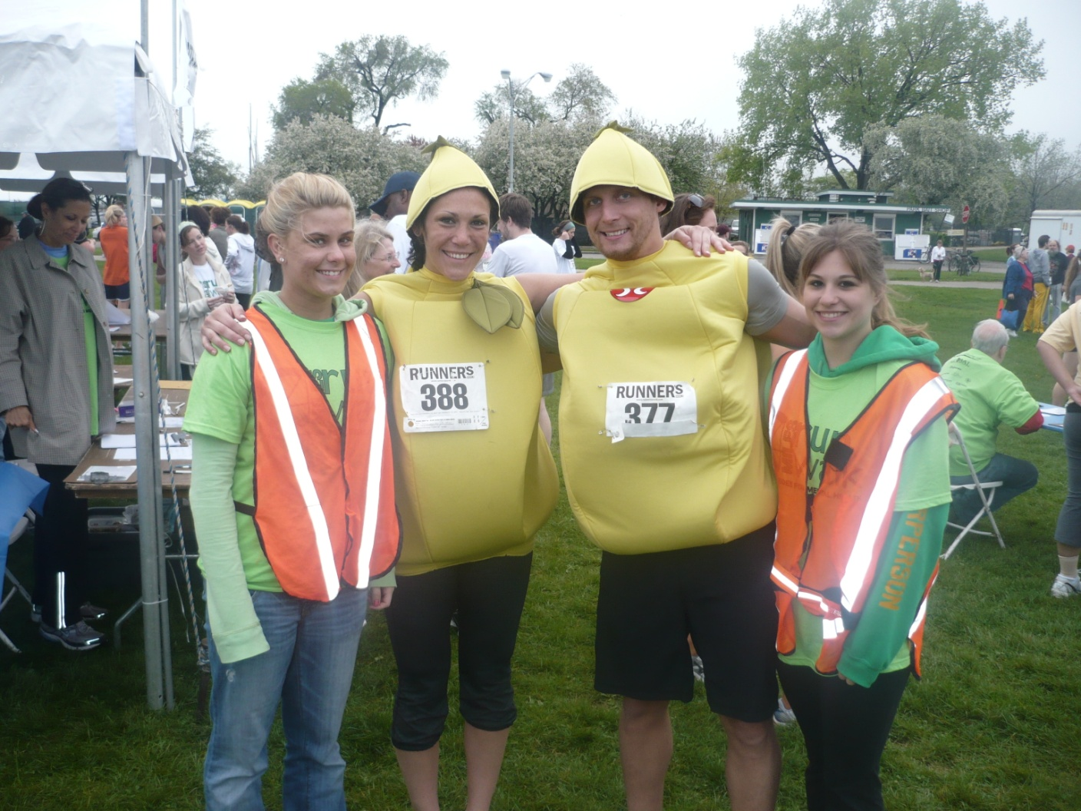
Monthly Newsletters

Slide 17
Your editor puts together a monthly newsletter that will be distributed to you during our meetings. In this newsletter you can read about past events, and find out information about upcoming events. You can also submit articles for the newsletter to get service hours. You can e-mail your editor with an article about an event you went to by using a specific format and sending it to : mmastalerz93@gmail.com
She puts in a lot of hard work in them, so take the time to read them! ☺

Slide 18
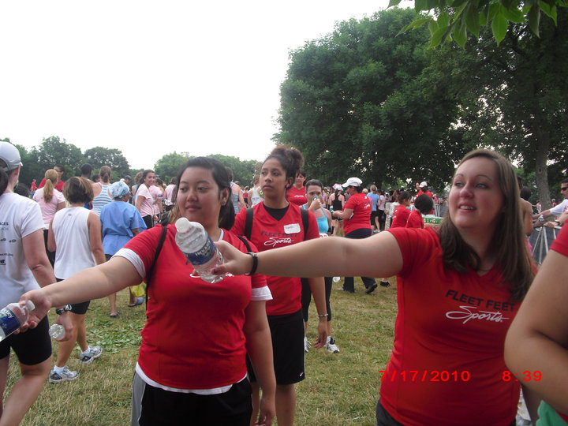
Facebook & Twitter: Lane Tech Key Club

Slide 19
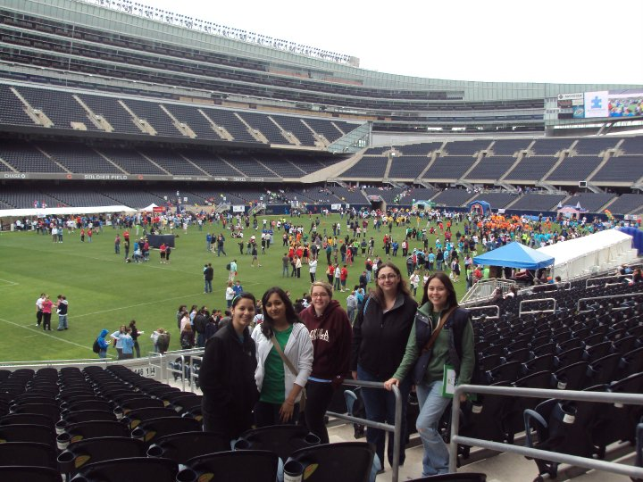
lanetechkeyclub.yolasite.com
This is our website. It is updated regularly. Here you can find info about events and contact information for our officers, in case you need it.

Slide 20
lt_key_club@yahoo.com
This is our e-mail address. Responses are usually quick, so don’t hesitate!

Slide 21
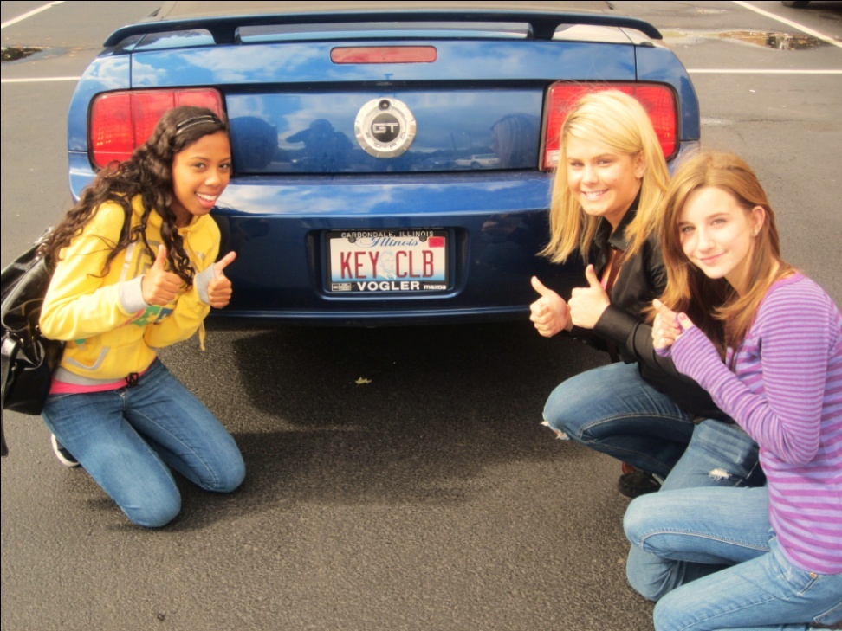
Check your e-mails and Facebooks regularly!
We send e-mails and Facebook messages to keep you updated on events and meetings.

Slide 22
Be an Active Member
There’s nothing worse than a lousy Key Club member.
We’re supposed to be avid helpers to our community.
There are perks!

Slide 23
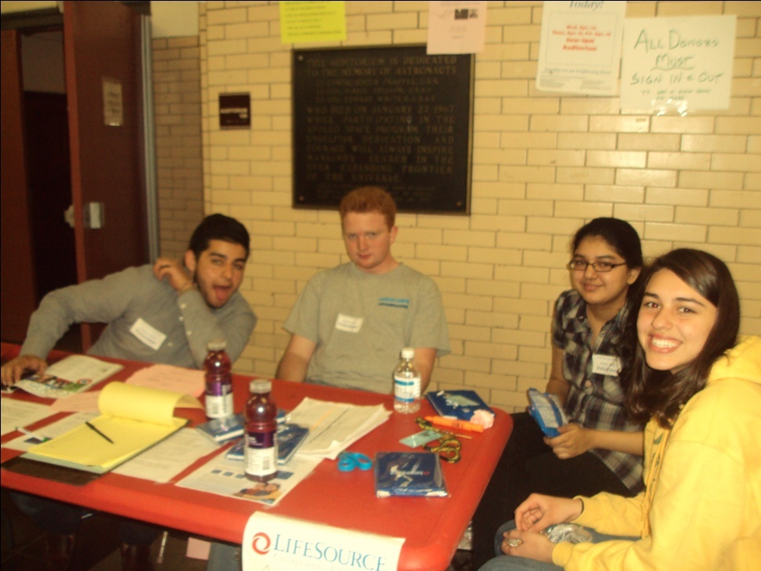
Member of the Month
A member who performs the most service hours during the month receives a certificate acknowledging their achievement. This looks great for college!

Slide 24
Don’t Forget the Pledge!
I pledge, on my honor, to uphold the Objects of Key Club International; to build my home, school and community; to serve my nation and God; and combat all forces which tend to undermine these institutions.
This pledge is spoken by us Key Clubbers at each meeting, so make an effort to memorize it!

Slide 25
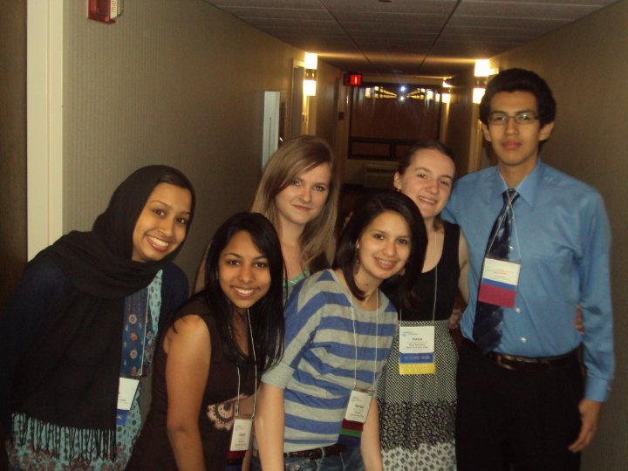
Think About It
Lane Tech Key Club boasts a membership of hundreds of students, while other schools have less than 50 members. We can do a lot more than “other schools”. So put an effort towards serving your community. It’s truly a beautiful, meaningful thing to do.

Slide 26
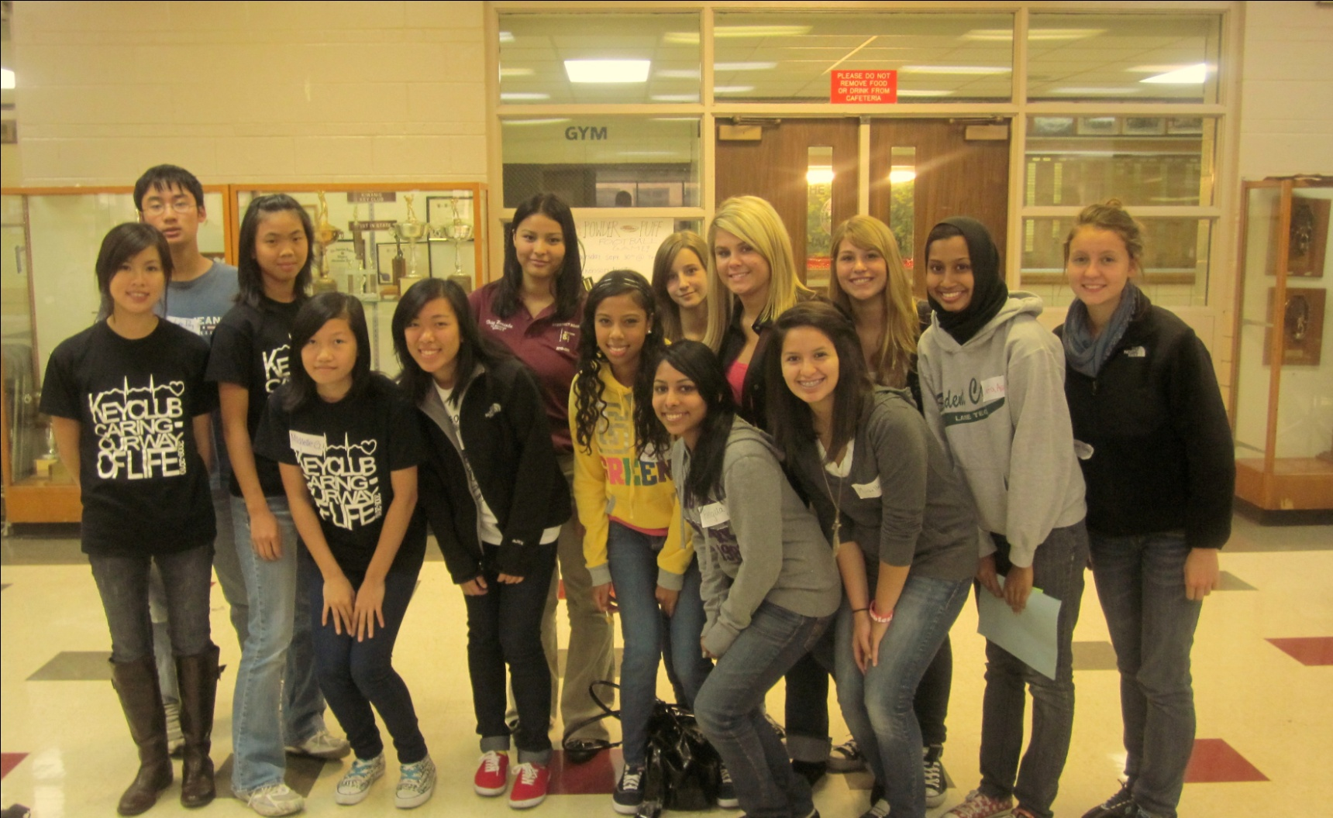
So Let’s Have a Wonderful Year!

Slide 27
Notes:
Click on the box to start slideshow.

